Slide 1
Faithful at work
Mike Beasley
St Martin’s Men’s Breakfast
14th November 2020

Slide 2
Outline
My own work history
Why do we work?
How do we work?
Fellowship and witness in the workplace

Slide 3
My own work history
Bentalls department store, Kingston on Thames
Central Electricity Research Laboratories, Leatherhead
ICL/Fujitsu, various locations including home

Slide 4
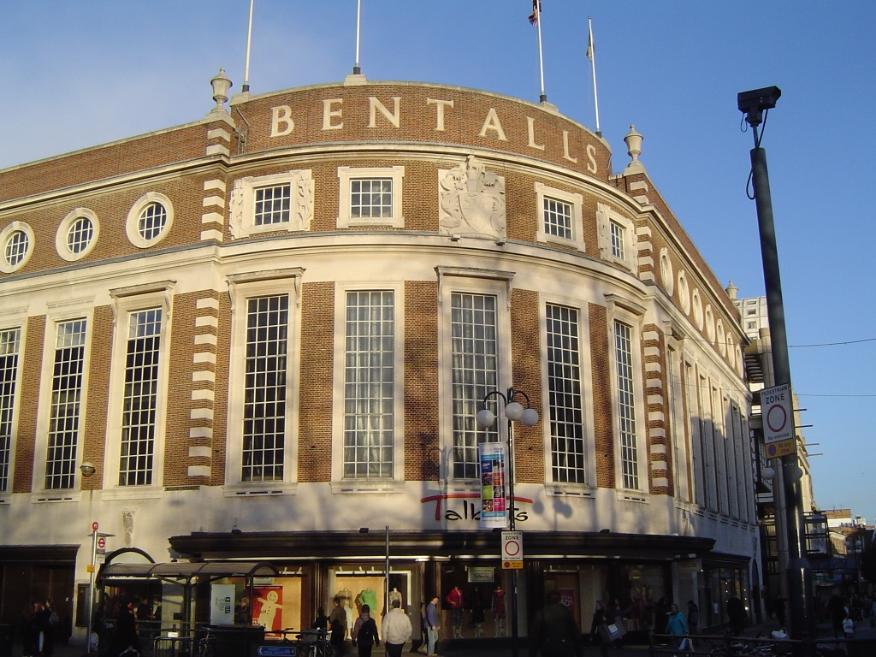

Slide 5
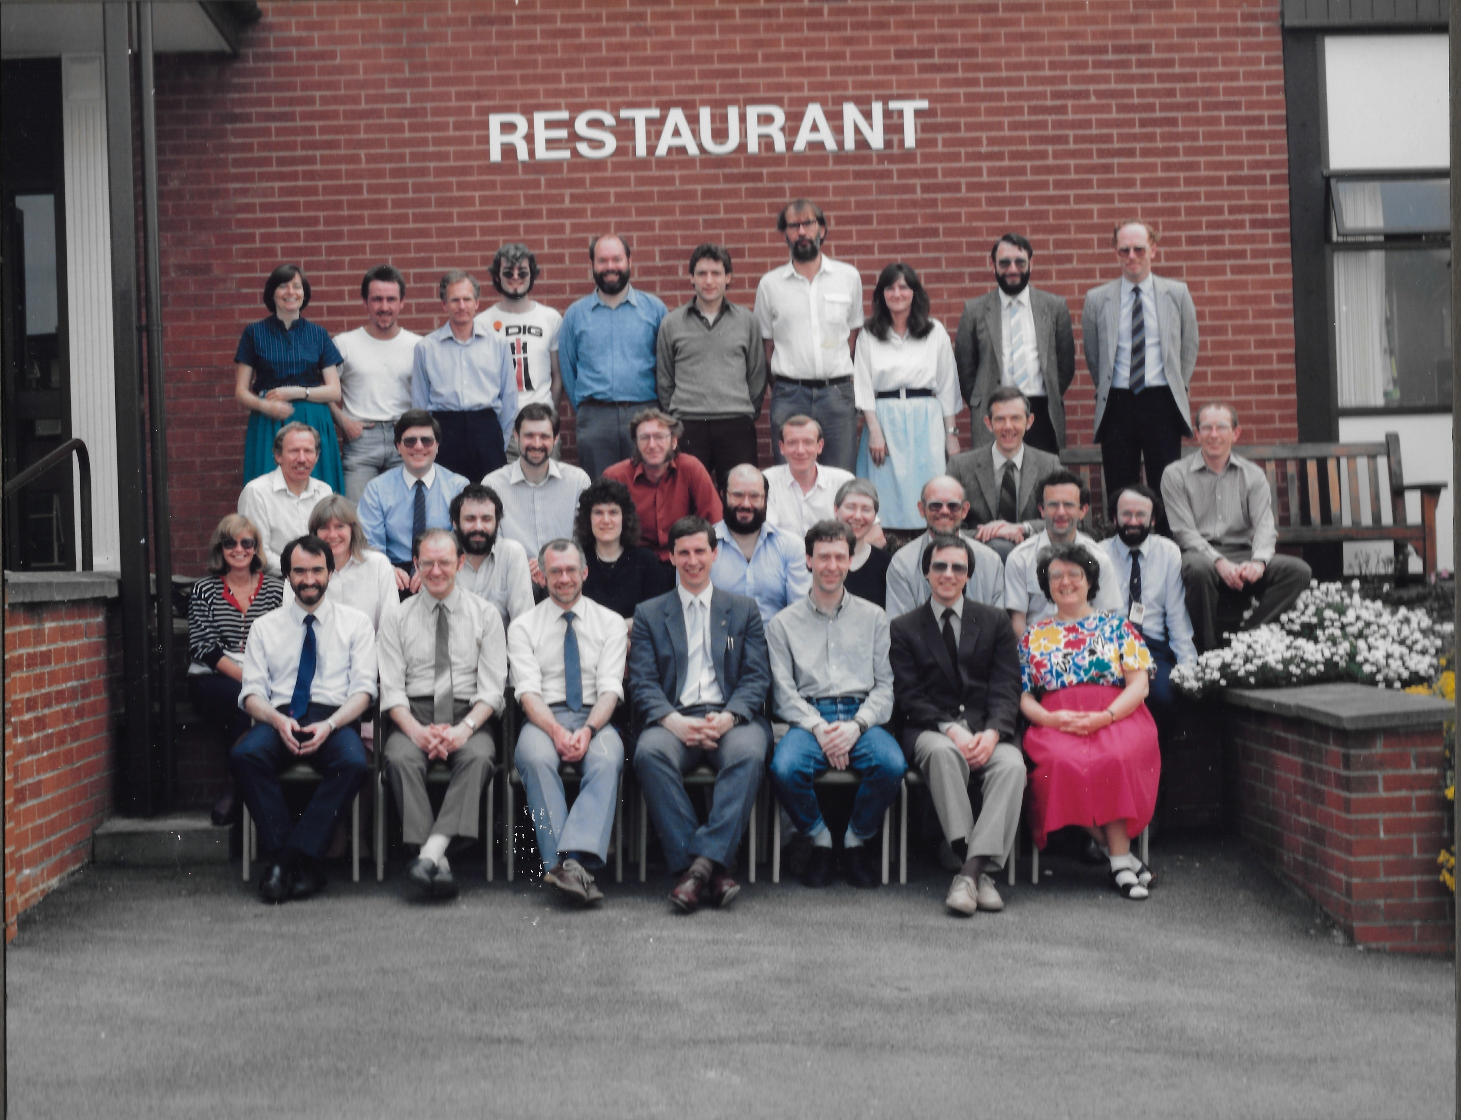

Slide 6
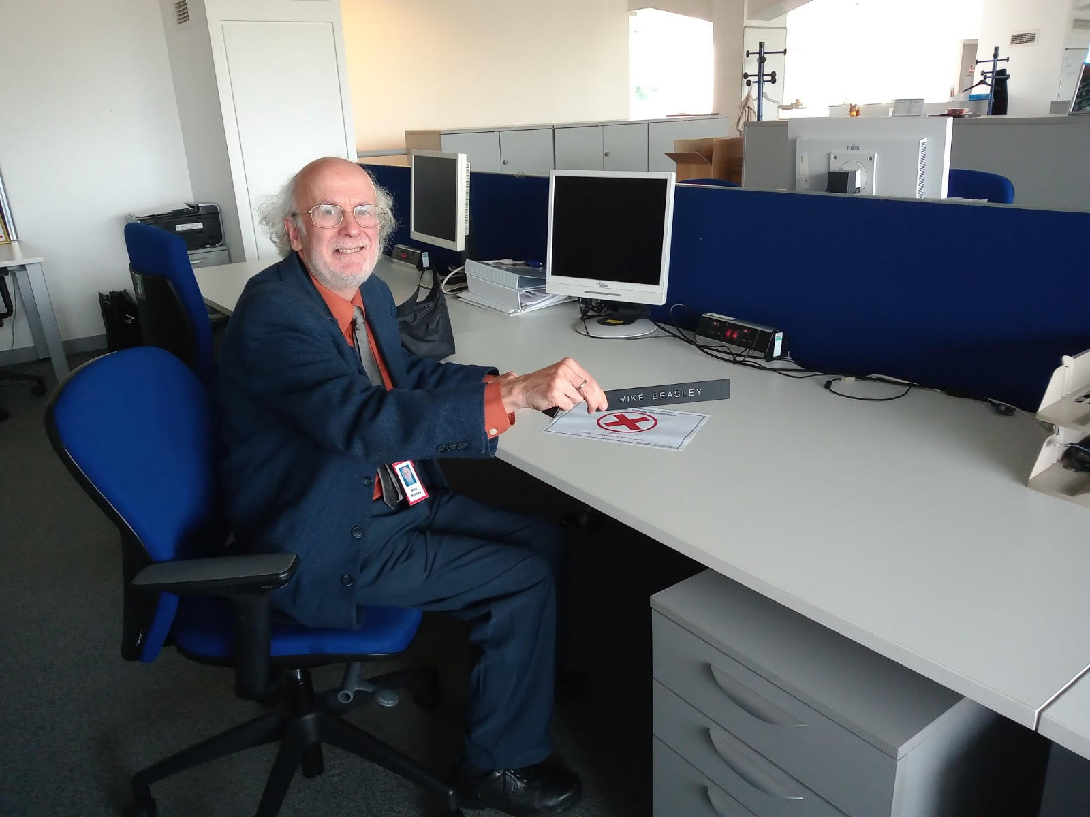

Slide 7
Why do we work?
Part of God’s plan (Gen 2:15)
Providing for self and family (2 Thess 3:10, 1 Tim 5:8)
Contribution to society
God works, Jesus worked (Gen 2:2, John 5:17)
Not just to earn money for the Kingdom of God, or to meet non-Christians

Slide 8
How do we work?
As serving God and not men (Col 3:23-24)
What about working on Sundays?
Work/life balance, overwork
Honesty, corruption
Conflicts – what’s worth making a stand for?
Management, ambition

Slide 9
Fellowship and witness in the workplace
Christian workplace groups
Encouragement and support
Prayer for management and colleagues
Fellowship outside your own church
Christians at Work, Transforming Work UK
Virtual fellowship in Fujitsu
Monthly prayer email
Weekly conference call

Slide 10
Fellowship and witness in the workplace (continued)
My experience in Malaysia
Witness
Walk and talk
Fish badges, Christian calendars …
Be ready to give an answer (1 Peter 3:15-16)
Christian organisations (Mercy Ships lunchtime table and Dragon Boat race)

